Slide 1
Research Update
Daniel Olofin Clonal Redesign Lab
04 – Aug 2025
Objective:
To model the evolution of chromosomal copy number profiles in cancer cell lines under different conditions, including Control, Glucose 1, and Glucose 2
Method: Use of a discrete-time stochastic process to simulate karyotypic changes over time, with the goal of reproducing late-phase experimental profiles by adjusting chromosome-level gain and loss probabilities.

Slide 2
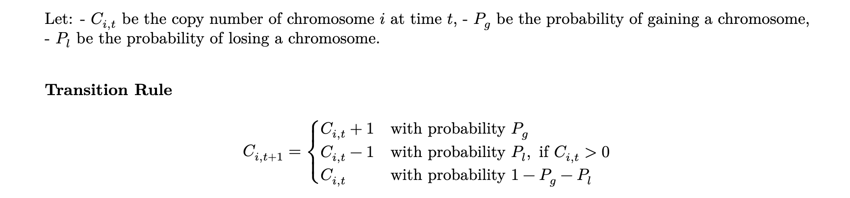
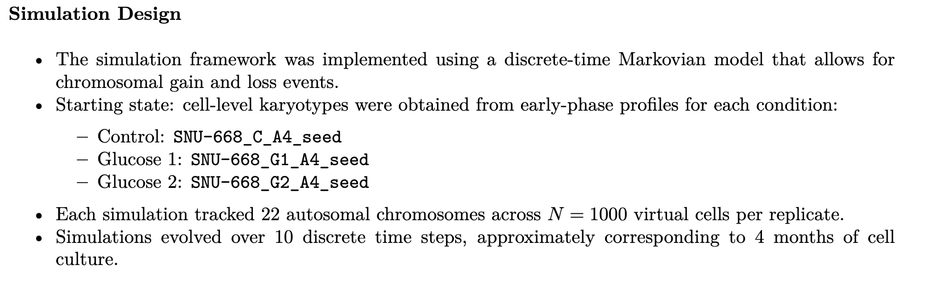
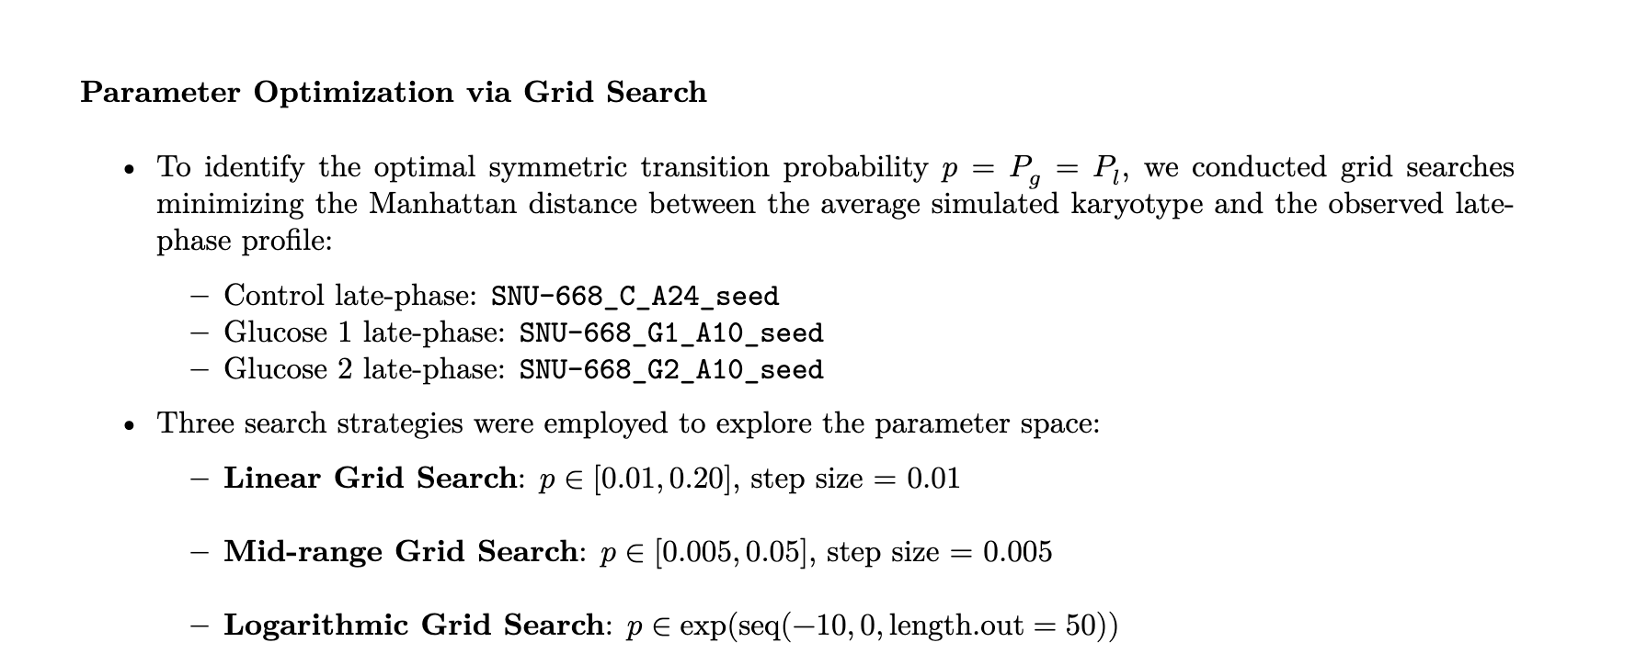
Method
Concept
State | Copy numbers of 22 chromosomes in a single cell.
Initial State | A real early-stage control cell’s karyotype
Time Steps | Each iteration (t = 1 to 10) represents chromosomal change events
Transition | At each time step, every chromosome can: gain (+1), lose (–1), or stay the same (0)
Transition Probabilities | Controlled by parameters p_gain = p_loss, and 1 - p_gain - p_loss

Slide 3
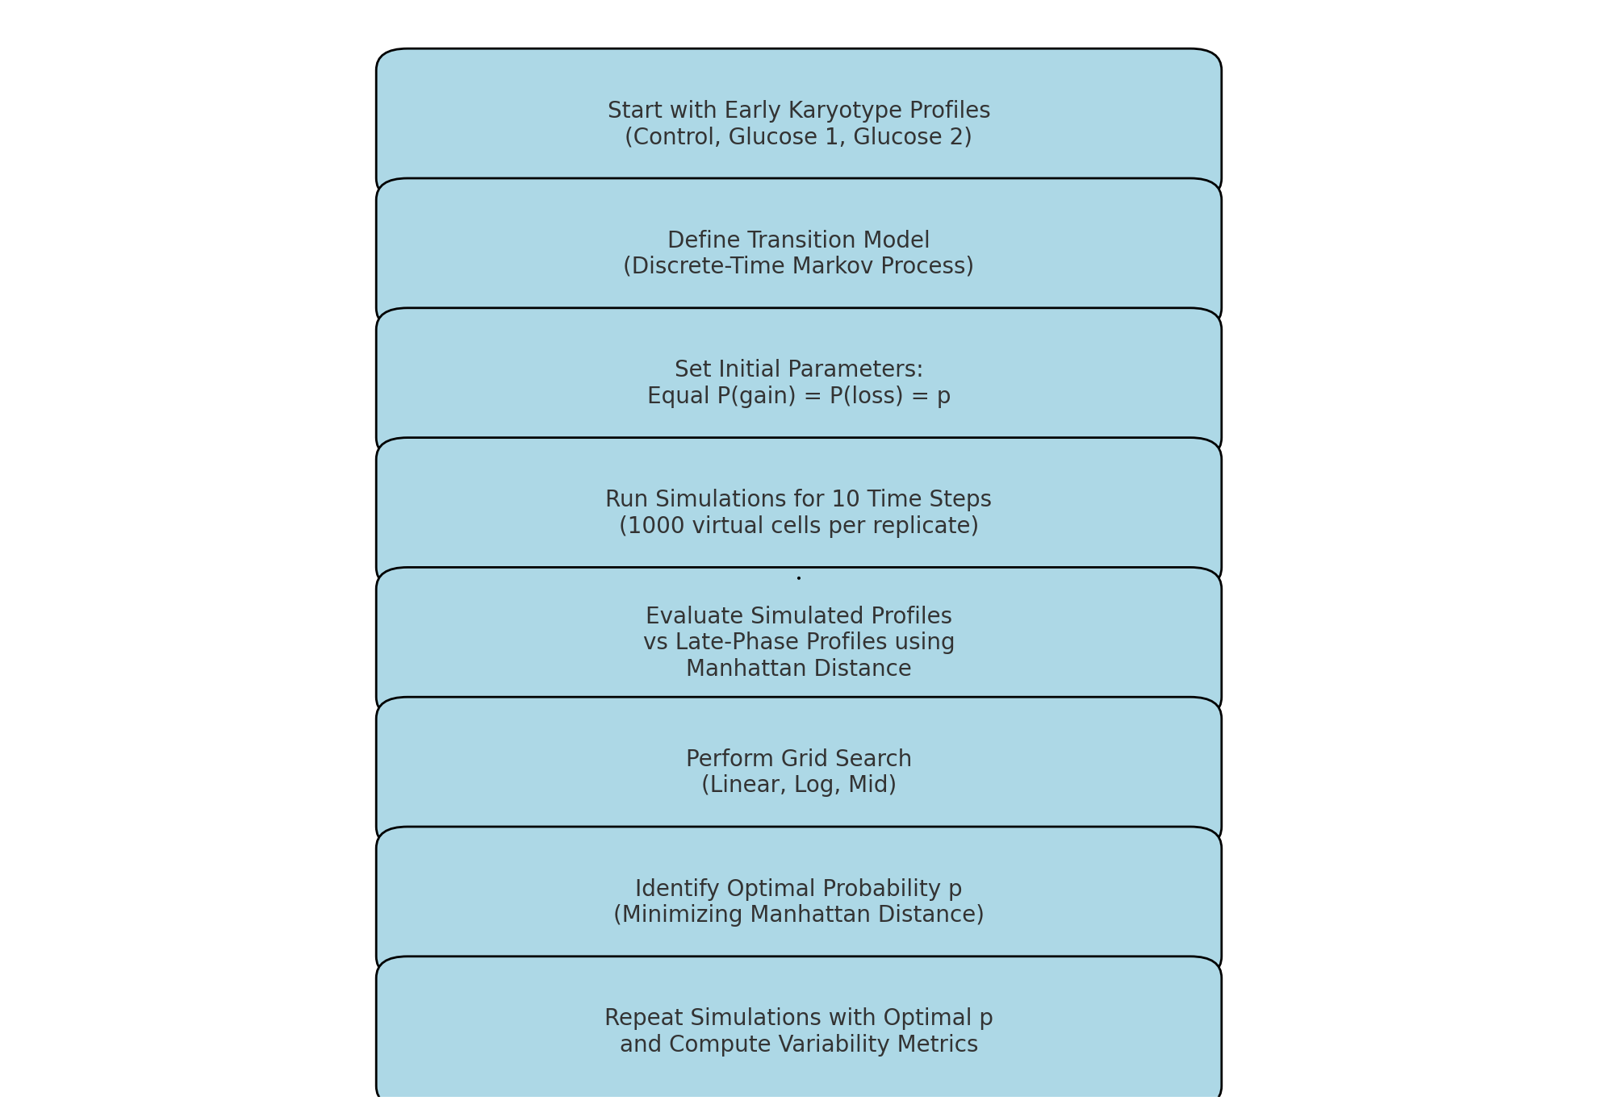
Work Flow

Slide 4
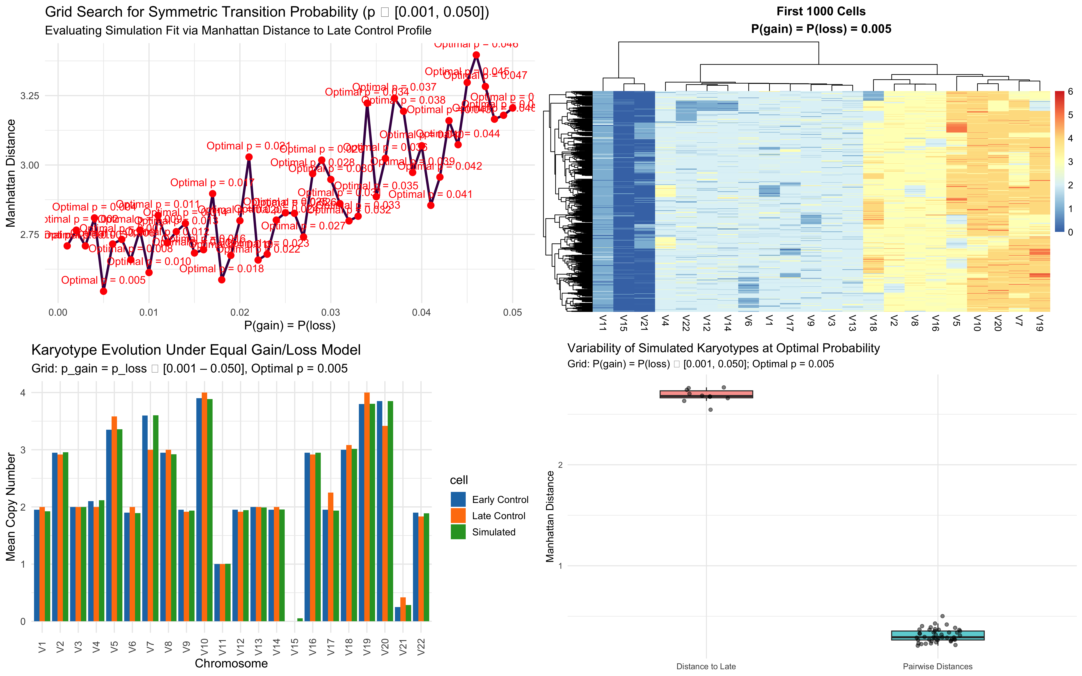
Results – Control using Linear Grid Search

Slide 5
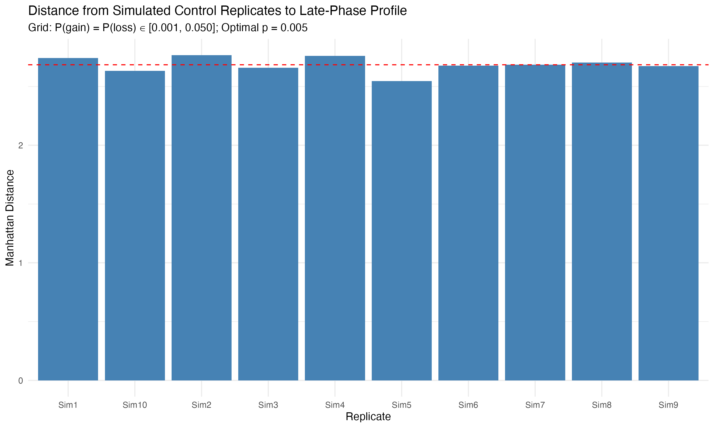
Results – Control using Linear Grid Search

Slide 6
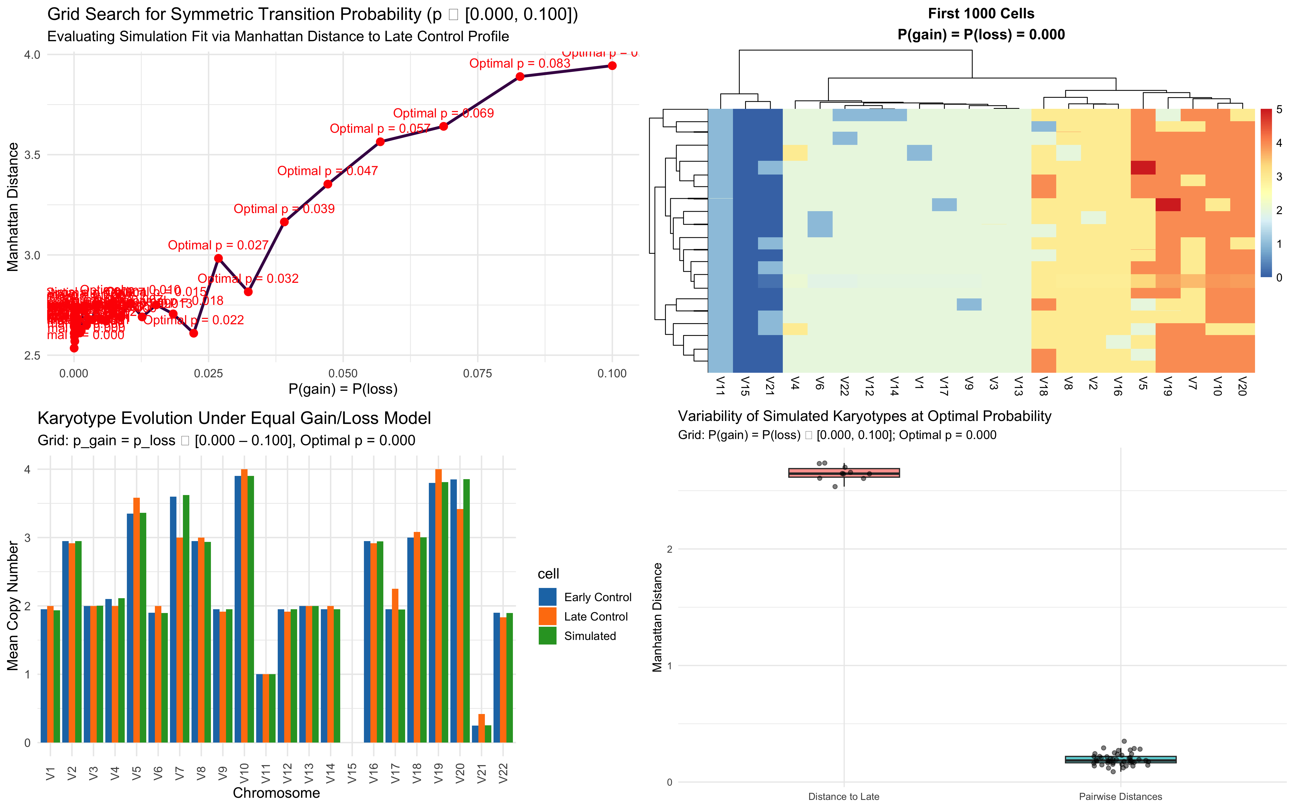
Results – Control using Log Grid Search

Slide 7
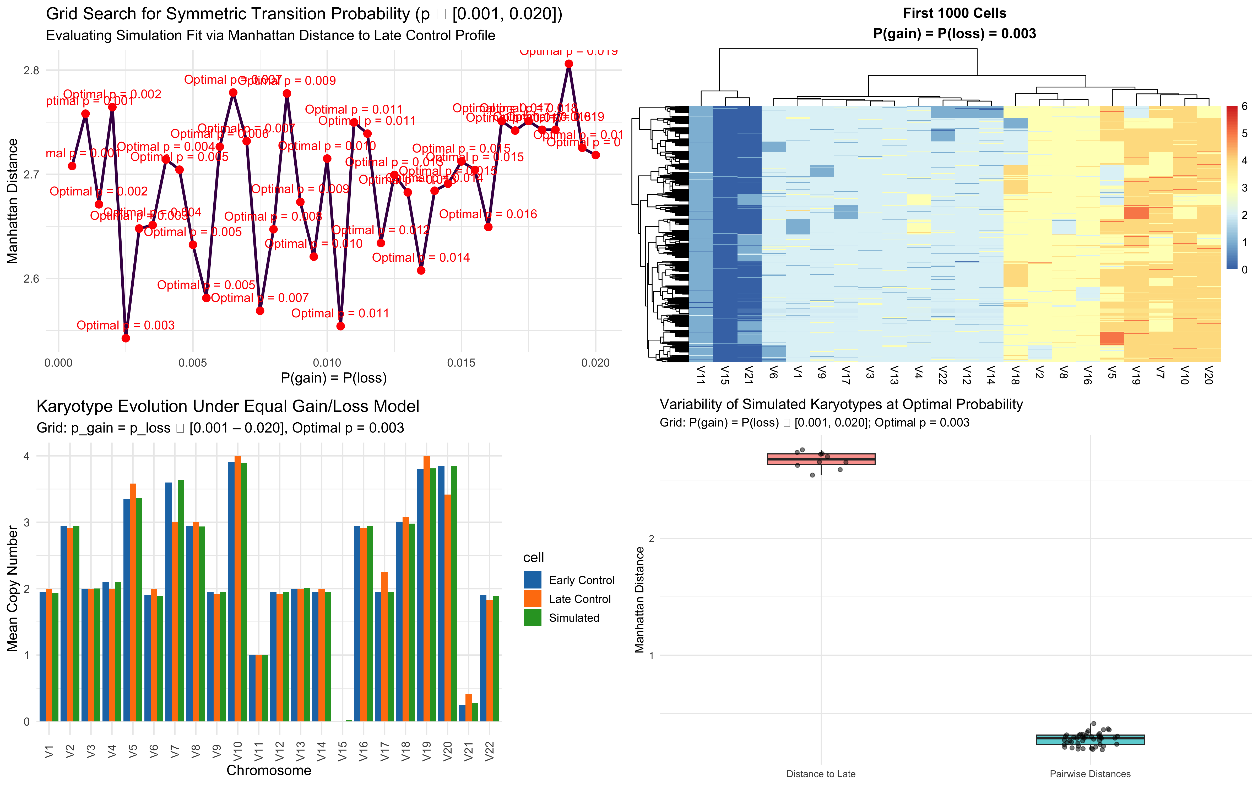
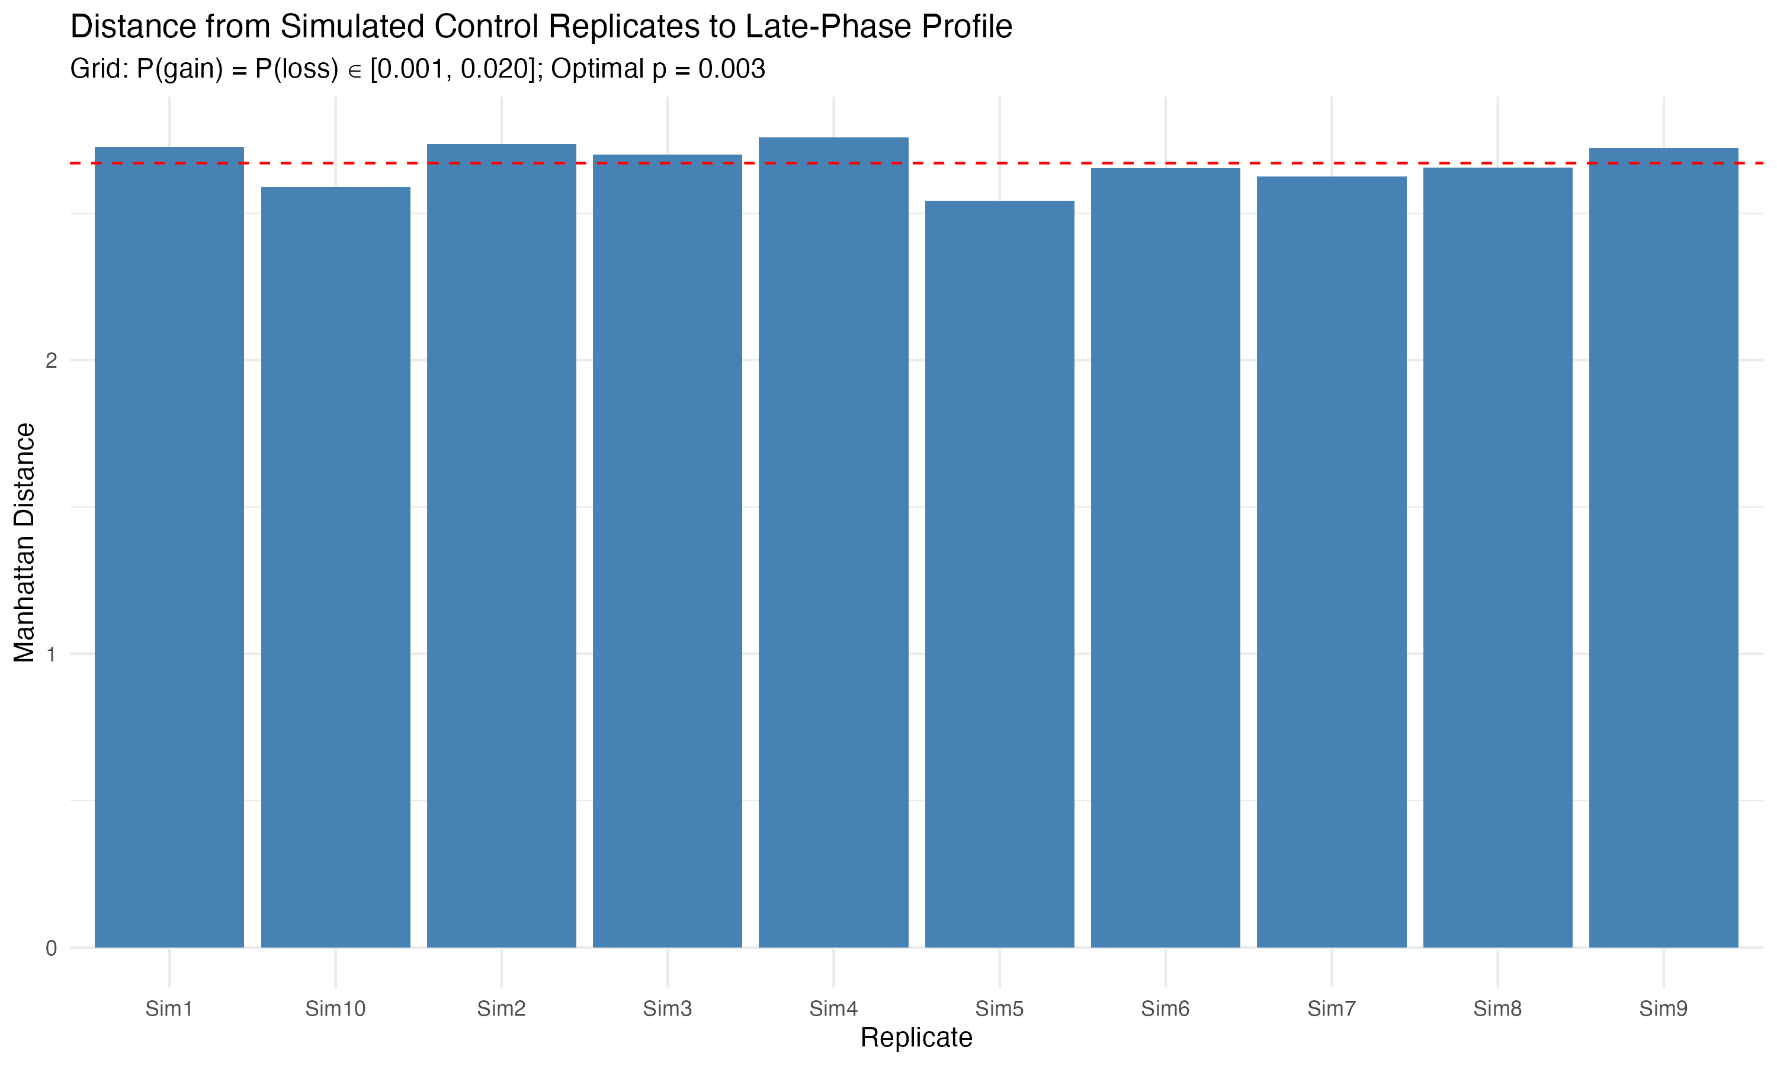
Results – Control using Mid Grid Search

Slide 8
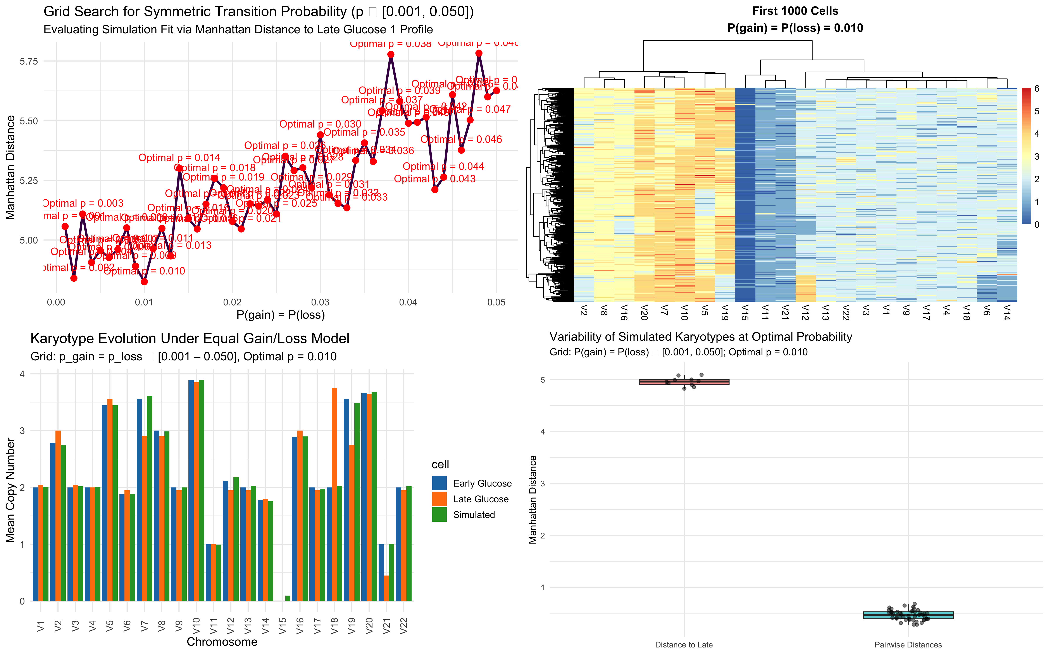
Results – Glucose 1 using Linear Grid Search

Slide 9
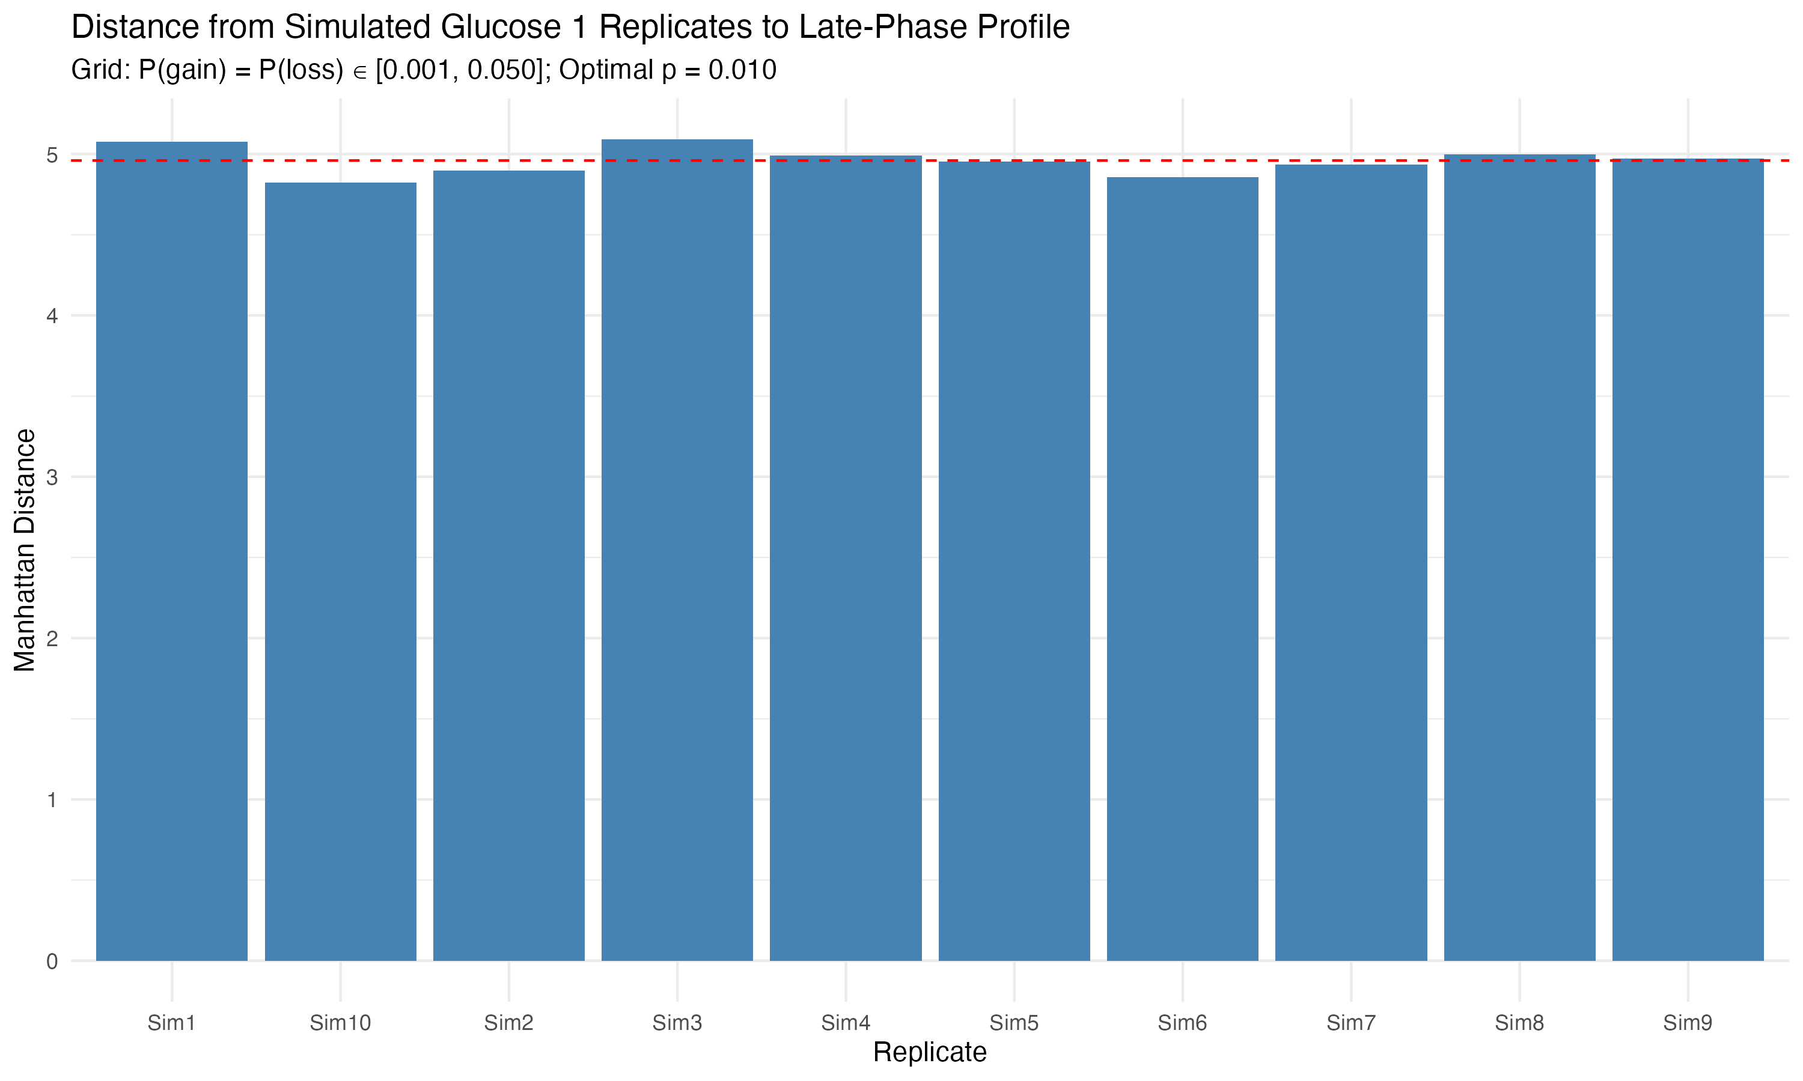
Results – Glucose 1 using Linear Grid Search

Slide 10
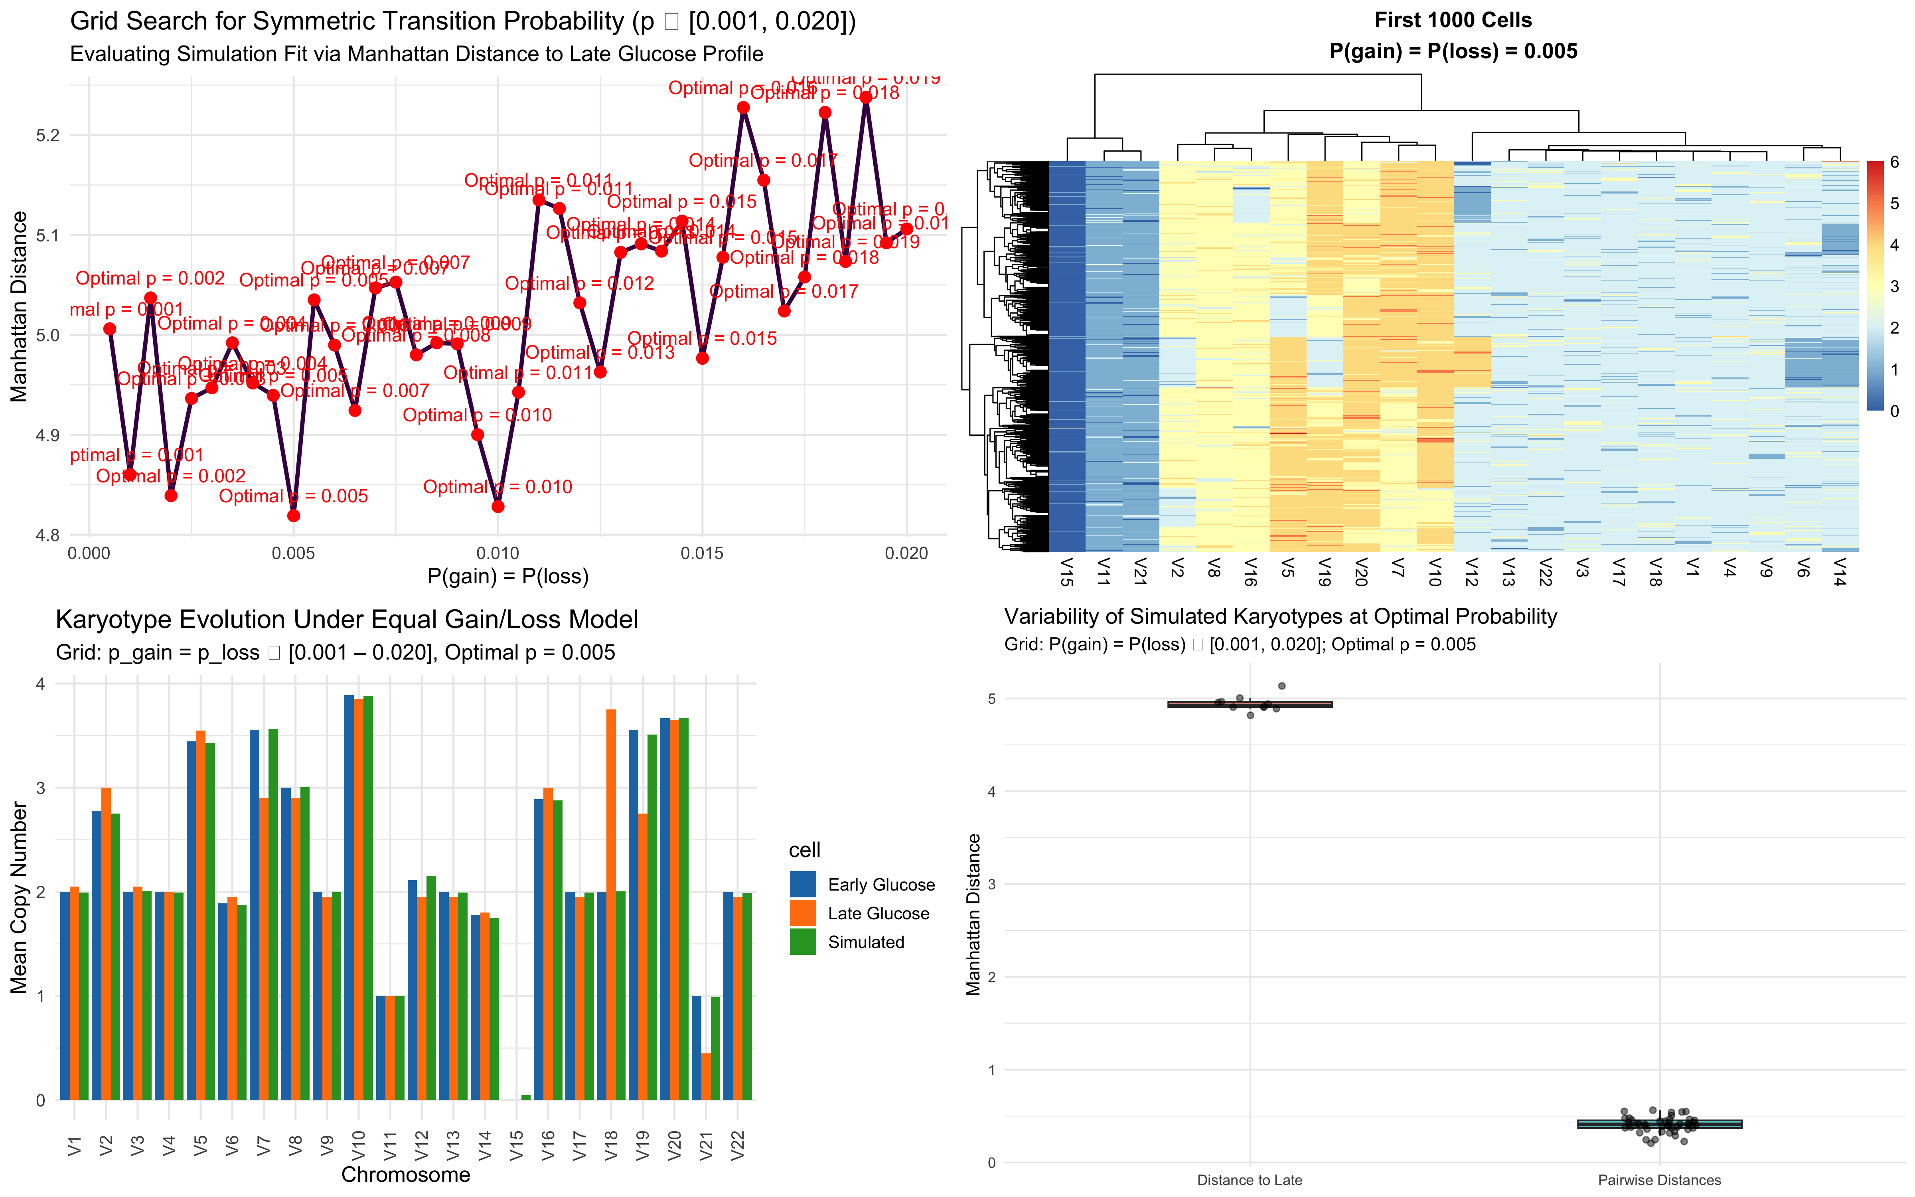
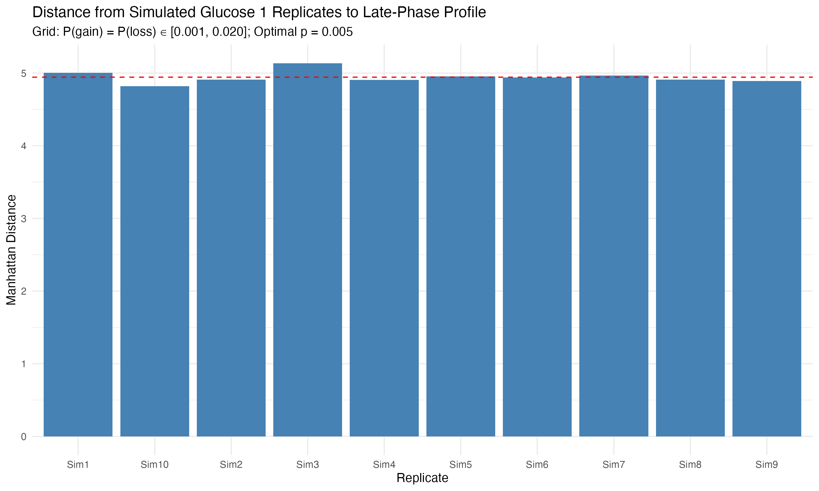
Results – Glucose 1 using Mid Grid Search

Slide 11
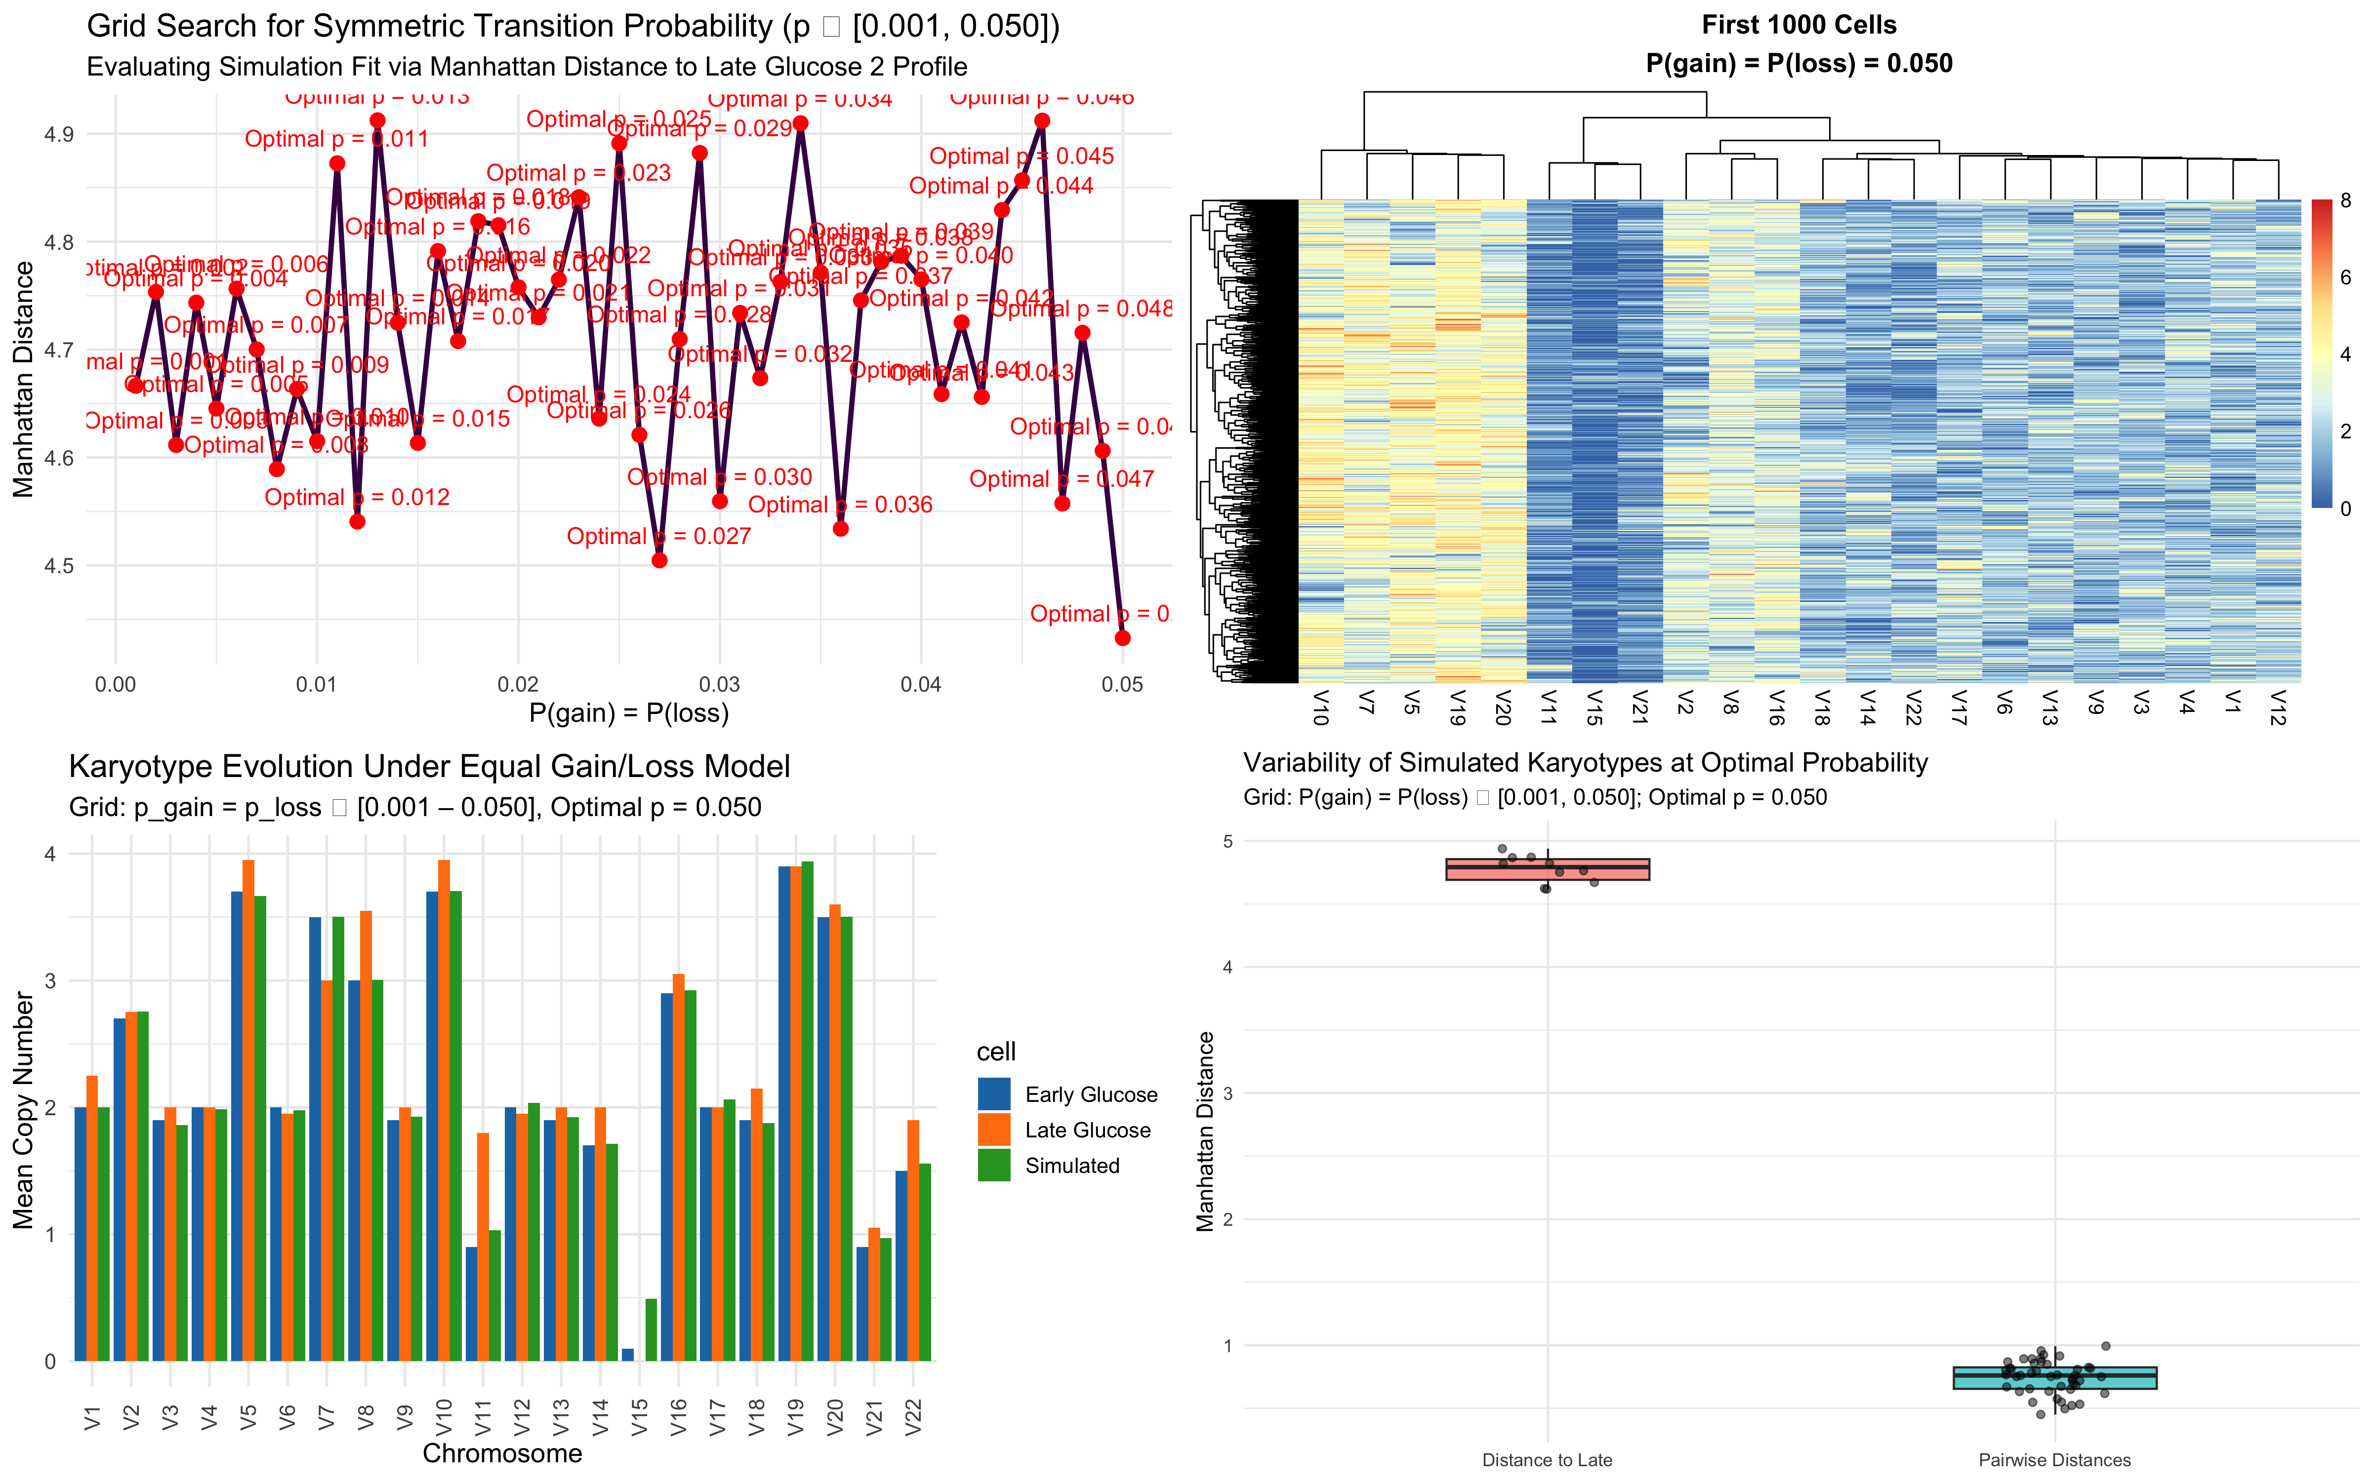
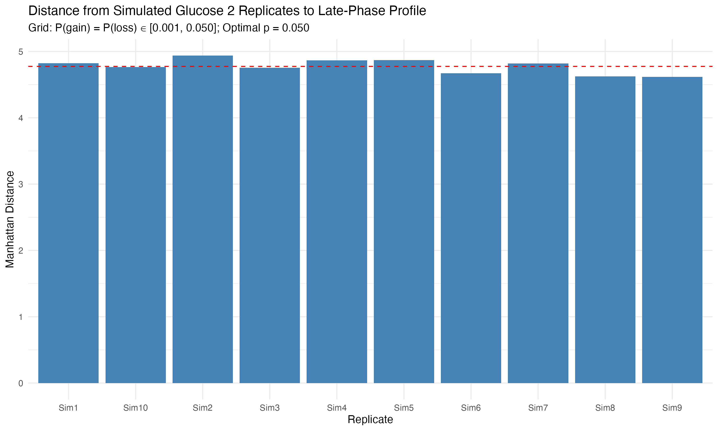
Results – Glucose 2 using Linear Grid Search

Slide 12
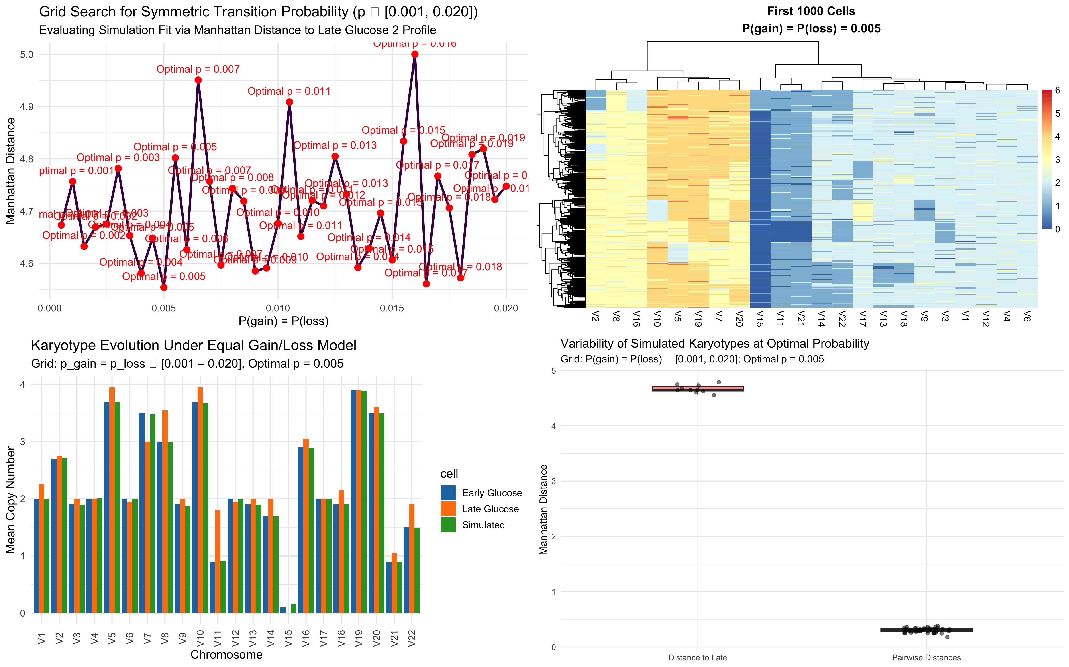
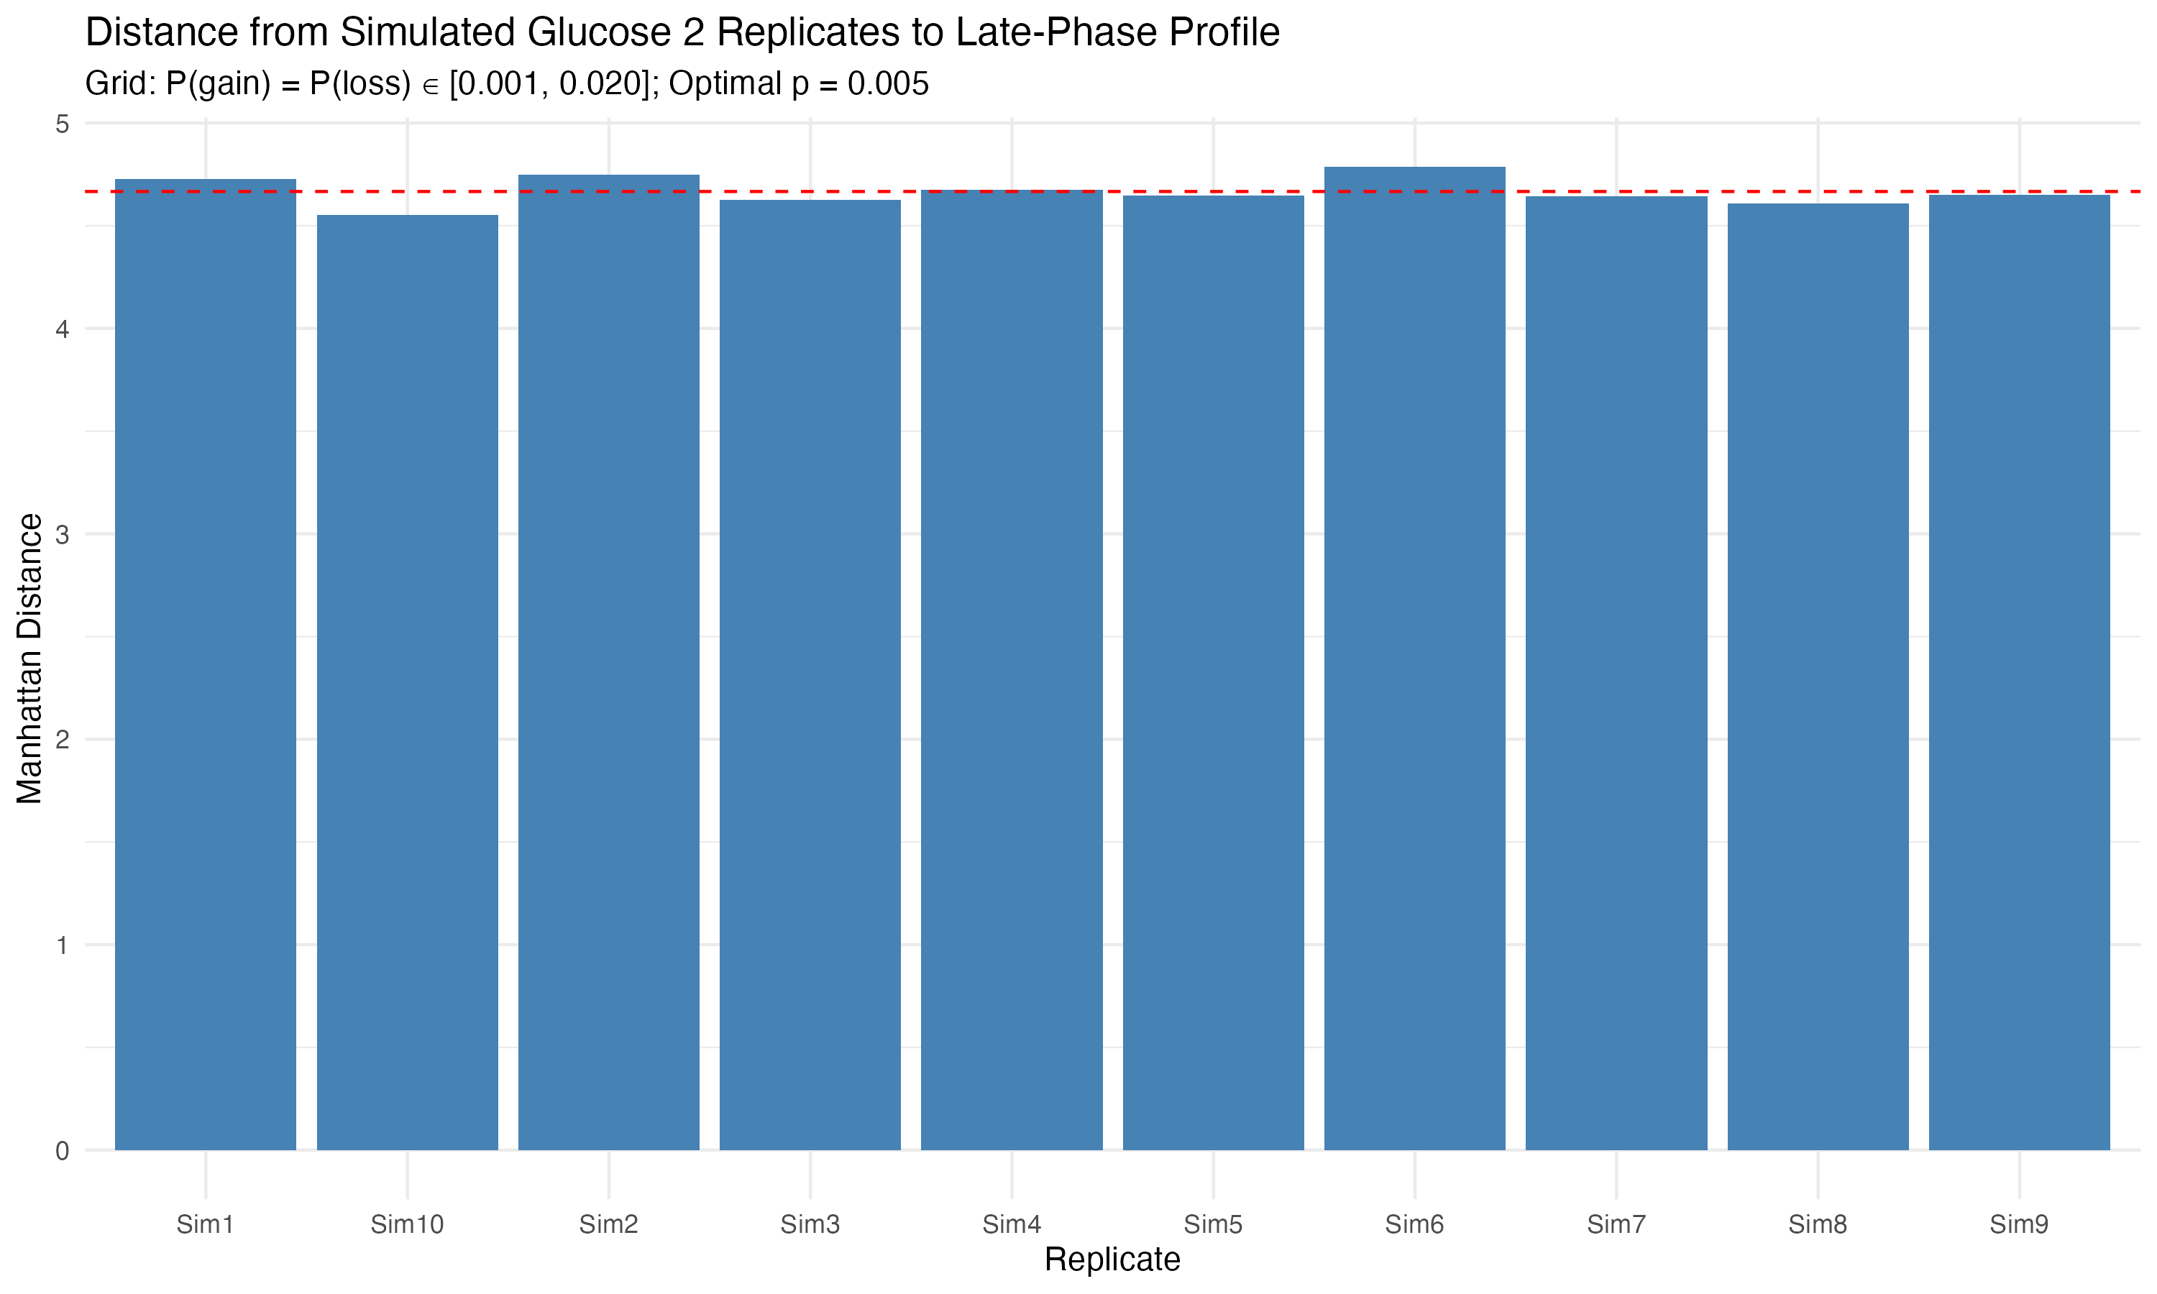
Results – Glucose 2 using Mid Grid Search

Slide 13
Conclusions
Future Direction
The symmetric gain/loss Markov model don’t captures chromosomal dynamics under baseline (Control) conditions, validating that we need to improve the modeling for stable karyotype evolution.
Under stress-induced conditions (e.g., Glucose 1 and Glucose 2), the model fails to reproduce observed profiles, highlighting the need for more advanced models that incorporate asymmetric transitions and condition-specific selective forces.
Explore hybrid models combining mechanistic simulations with machine learning techniques to learn transition structures from data.
Integrate lineage-tracing data to capture clonal evolution trajectories.
Introduce asymmetric transition probabilities to reflect directional chromosomal changes under selective stress.
Add some biological parameter if possible.

Slide 14
Thank You!!!

